Slide 1
A Guide to Zookeeper, Kafka and Docker

Slide 2
WHO

Slide 3

Bello
Muhammad
ETCBASE

Slide 4

Contents
What is Zookeeper?
How to Install Zookeeper
Standalone Minimal Configurations
What is Apache Kafka?
The Concepts
Kafka Core APIs
Topics and Logs
Producers and console client
Consumers and console client
What is Docker?
Docker Container and Running Ngnix container
Docker Container Management Commands
Docker Image and Management Commands
Creating Our Image and Running it in a Container
Docker Compose with Spring Boot Application
Conclusion

Slide 5

Zookeeper:
A high-performance coordination service for distributed applications.

Slide 6
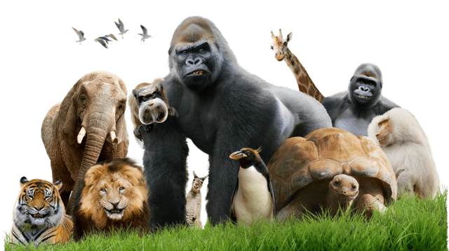
Usage:
Centralized service for distributed systems to a hierarchical key-value store,
Distributed configuration service,
Synchronization service, and
Naming registry for large distributed systems

Slide 7
How to Install Zookeeper:
Download link: https://zookeeper.apache.org/releases.html#download
$> tar -xzf zookeeper-version.tar
$> cd zookeeper-version
The server can then be run.

Slide 8

Zookeeper Standalone Minimal Configurations:
Editing zoo.cfg in config/zoo.cfg
tickTime=2000
dataDir=/file/path/fileName
clientPort=2181

Slide 9

Apache Kafka:
Apache Kafka is a distributed streaming platform.
Publish and subscribe to streams of records.
Store streams of records in a fault-tolerant durable way.
Process streams of records as they occur.

Slide 10
Cont.
Kafka is generally used for two broad classes of applications:
Building real-time streaming data pipelines and
Building real-time streaming applications

Slide 11
The Concept:
Kafka is run as a cluster
Records are in categories called topics.
A record has a key, a value, and a timestamp.

Slide 12
Kafka Core APIs:
Kafka is run as a cluster
Records are in categories called topics.
A record has a key, a value, and a timestamp.

Slide 13
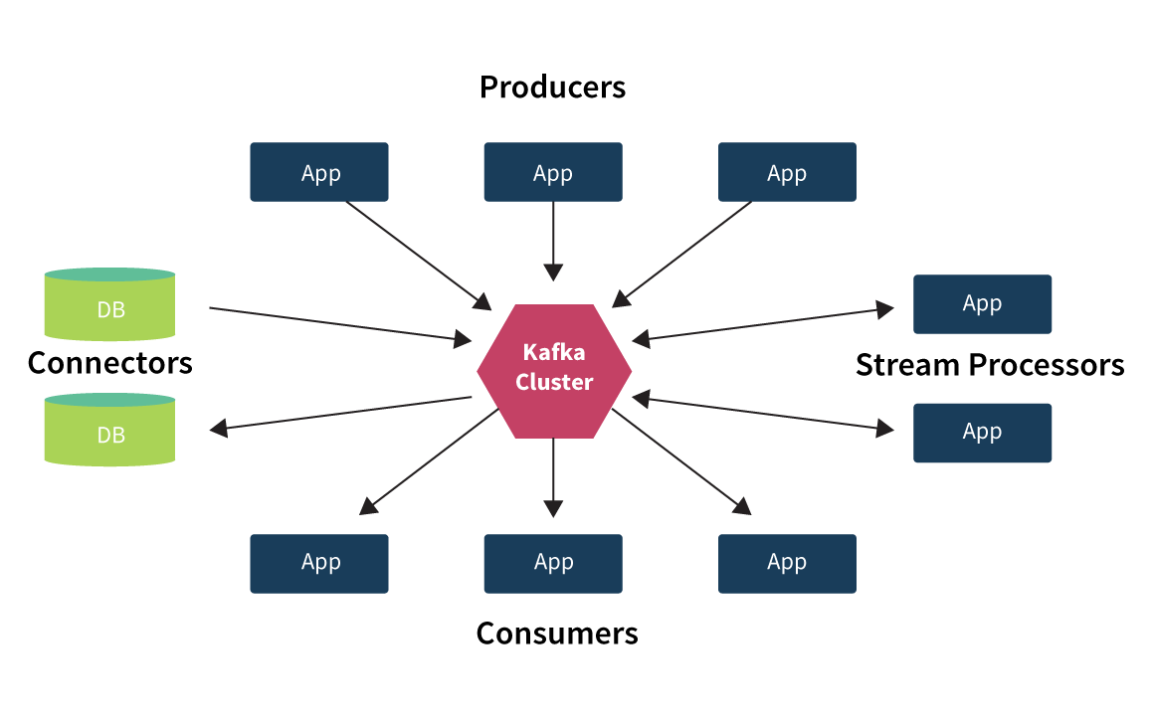
Kafka Core APIs:

Slide 14
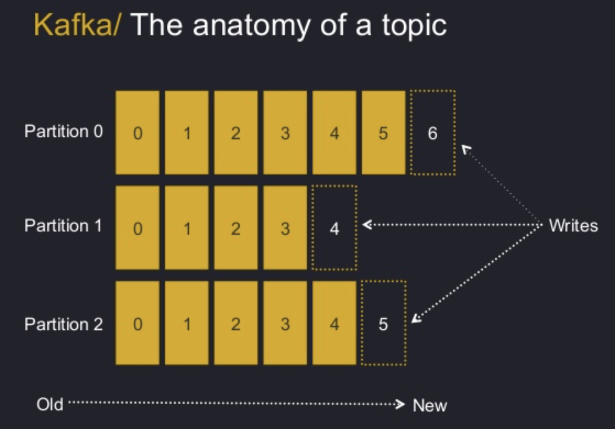
Topics and Logs:
A topic is a category or feed name to which records are published. For each topic, the Kafka cluster maintains a partitioned log that looks like this:

Slide 15
Producers:
Producers publish data to the topics of their choice. The producer is responsible for choosing which record to assign to which partition within the topic.

Slide 16
Consumer:
Consumers label themselves with a consumer group name, and each record published to a topic is delivered to one consumer instance within each subscribing consumer group.

Slide 17
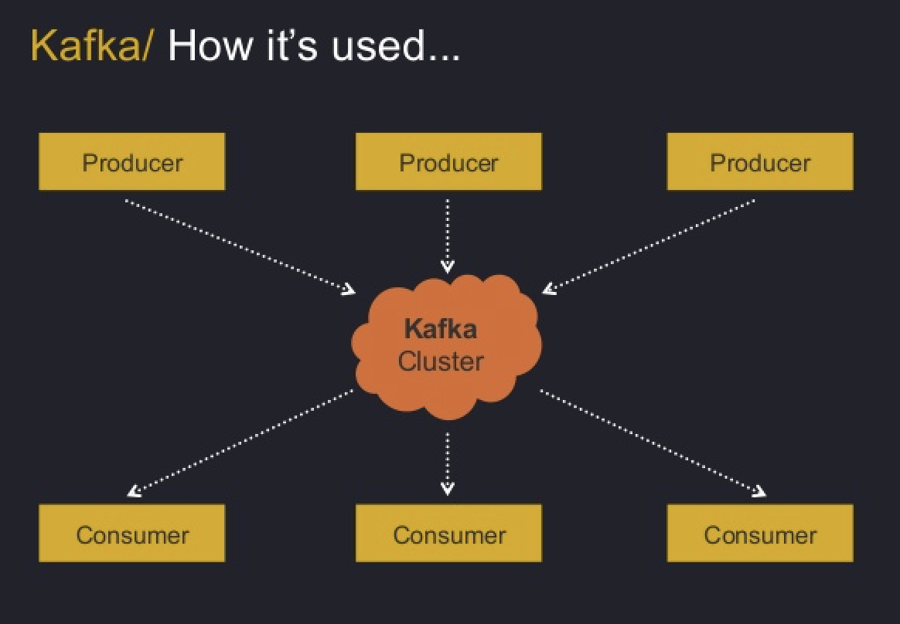

The might:

Slide 18

Installing and Starting Kafka

Slide 19
Cont.
Download link: https://www.apache.org/dyn/closer.cgi?path=/kafka/2.1.0/kafka_2.11-2.1.0.tgz
$> tar -xzf kafka_version.tar
$> cd kafka_version
Starting Kafka:
$> ./bin/kafka-server-start.sh config/server.properties

Slide 20
Creating a topic:
Create:
$> ./bin/kafka-topic.sh --create --zookeeper hostName:2181 --replication-factor 1 --partition 1
List Topics:
$> ./bin/kafka-topic.sh --list --zookeeper hostName:2181

Slide 21
Messaging With Console Clients:
Starting console producer client:
$> ./bin/kafka-console-producer.sh --broker-list hostName:9092 --topic topicName
Starting console consumer client:
$> ./bin/kafka-console-consumer.sh --bootstrap-server hostName:9092 --topic topicName --from-beginning

Slide 22

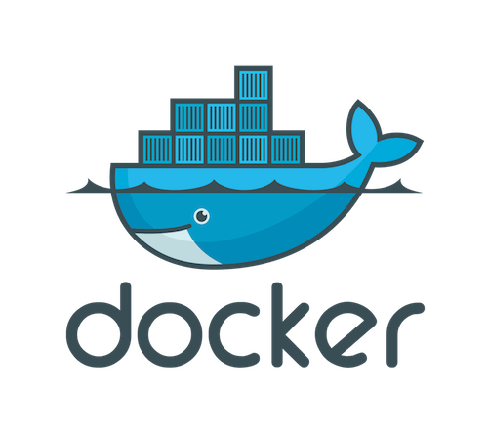

Slide 23
Cont.
Docker is a computer program that performs operating-system-level virtualization.
Docker is a tool designed to make it easier to create, deploy and run applications by using containers.
Easier to create, deploy and run applications by using containers.
Docker allows applications to use the same linux kernel.

Slide 24
Docker Container:
$> docker version
$> docker info
$> docker container run -it -p 8080:8080 tomcat
$> docker container run -d -p 8080:8080 tomcat
$> docker container run -d -p 8080:8080 --name containerName tomcat
$> docker run -d -p 8080:8080 imageName

Slide 25
Container Management:
$> docker container ls (ls -a)
$> docker ps (ps -a)
$> docker container stop containerName/Id
$> docker container rm containerId
$> docker container rm -f containerId
$> docker rm $(docker ps -aq) -f

Slide 26
Docker Images:
Docker uses local image or download from docker hub.
$> docker pull imageName(e.g. tomcat)
$> docker images
$> docker image rm imageId

Slide 27
Bashing Container:
After starting a container, we can bash into the container to work with the file systems.
$> docker container exec -it containerName bash
$> exit

Slide 28
Dockerfile:
To create docker image we need to create Dockerfile in the directory where we want to create the image.
FROM openjdk:9
ADD target/theJarFileName.jar /where/to/put/the/jar/in/docker/container
EXPOSE 8080
ENTRYPOINT [“java”, “-jar”, “theJarFileName.jar”]

Slide 29
Creating Image:
$> docker image build -t dockerUsername/imageName docker/file/directory (or . means current directory)
$> docker build -f Dockerfile -t imageName .
$> docker push dockerUsername/imageName

Slide 30
Docker Compose:
Compose is a tool for defining and running multi-container Docker applications.
Three Steps to compose:
Dockerfile
docker-compose.yml
docker-compose up (up -d)

Slide 31
docker-compose.yml:
version: '3'
services:
app:
container_name: my_app_container
restart: always
build: .
ports:
- '80:80'
links:
- mongo
mongo:
container_name: mongo
image: mongo
ports:
- '27017:27917'

Slide 32
Running Docker Compose:
$> docker-compose up (up -d)
$> docker-compose down

Slide 33

Thank You Very Much.

Slide 34
Q&A

